Slide 1
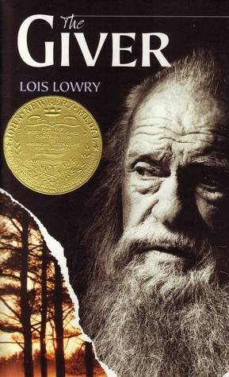
The giver
The giver is a dystopian novel by Lois Lowry.

Slide 2
Summary
Jonas, the main character in Lois Lowry’s novel, “The Giver,” lives like every other person in the community. They live in sameness, so everyone looks the same, does the same things, and acts the same. They are sheltered from everything that might change that, and everything that will hurt them. the ceremony of twelve, when Jonas is selected to be the new receiver of memory, changed that. He receives memories of the past, when everything was different. Everything that Jonas knew was changed. He knew things that no one else knew, and he must keep it to himself. One lesson in this book is that no one can be perfect.

Slide 3
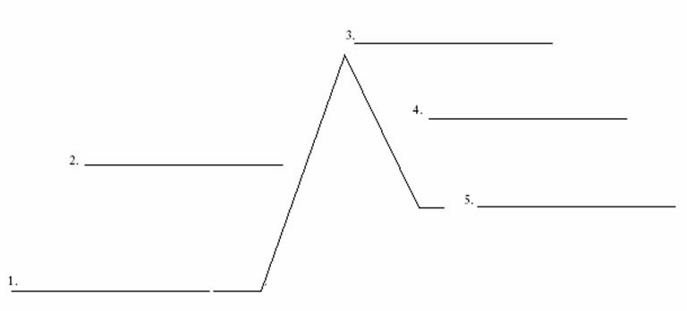
Plot Diagram
Jonas begins his training with The Giver and starts receiving memories.
Jonas and The Giver decide that they don’t like the way things are, and make plans to change them.
He is selected to be the new receiver of memory.
Jonas takes Gabriel and escapes from the community, so the memories will be released.
Jonas is anxious about the ceremony of twelve, where he will be assigned a role in the community.

Slide 4
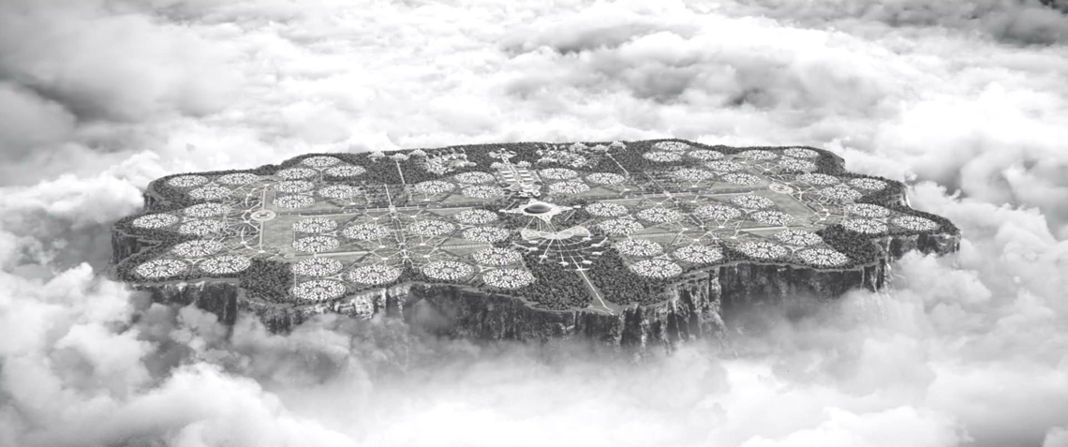
Setting and tone
"The Giver" takes place in a utopian society in the future, where everything is perfect. The elders have hidden all colors, pain, choices, and feelings.
I think that the tone of the story is confused and dark. It seems like there is always something we don’t know. It is like it is right in front of our faces but we can’t see it.

Slide 5
Jonas
Traits
Influences
Point of view
-Brave
-Intelligent
-Courageous
-Strong
-Kind
-Ambitious
-The Giver
-The rules
-Mother and Father
-Asher
-Fiona
3rd person

Slide 6
Main conflict
MAN VERSUS SOCIETY
Jonas is frustrated with the way things are in his community. He knows its not right but he doesn’t know how to change it. Jonas and The Giver formulate a plan.
“The worst part of holding the memories is not the pain. It’s the loneliness of it. Memories need to be shared

Slide 7
Theme #1
One theme is that you need to use memories from the past, when things went wrong, to make the future better by preventing those things from happening again.
On page 112, The giver explains to Jonas how he used the past to make the future better, “I used my wisdom. I knew that there had been times in the past- terrible times-when people had destroyed others in haste, in fear, and had brought about their own destruction.”

Slide 8
Theme #2
Another theme might be that no matter how hard you try, perfection is impossible and people will always make mistakes. There is nothing you can do to stop that.
On page 84, it said, “It wasn’t a practical thing so it became obsolete when we went to sameness.” This shows that when you try to be perfect, like they did, you end up farther from perfection than before.

Slide 9
Theme #3
A third theme might be that love will always prevail, and that nothing can get rid of it.
On page 126, after Jonas felt love for the first time, through a memory, he said, “I liked the feeling of love…I wish we still had that.”
Also, the movie, “the Giver” supports this theme. It showed how, no matter how hard the chief elder tried, she could not completely get rid of love.

Slide 10
The Giver AND Harry potter
The Giver
Harry Potter
-Main character “The Chosen One”
-muggles are hidden fro the magic of the wizard world.
-Albus Dumbledore teaches harry about magic
-Harry doesn’t go to Hogwarts until he turns eleven.
-Main character selected
-people are hidden from the memories of the past
-The Giver teaches Jonas about the real world.
-Jonas doesn’t receive the memories until he is twelve.

Slide 11
Most Impactful signpost
The most impactful signpost to me was when Jonas realized that he was the only person in the community with the experience of the memories. This changes the way he feels about his assignment.
“ ‘They have never known pain’ he thought. The realization made him feel desperately lonely.”

Slide 12
Conclusion
The most memorable aspect of this novel for me was
This book has a theme that I feel is very important, especially today. I learned that the past is so much more important than we think. Not only does it shape our future, but if we take the mistakes we have made in the past and apply them to now, we can make the future better for everyone.
I would recommend this book to my friend Delaney because I feel like she really likes these types of books. I think she would really like this book.

